Slide 1


A Project Presentation on
“ Movie Review Sentiment Analysis”
Presented By-
Kishore K S(1MJ17CS720)
Max Millen Pinto (1MJ17CS730)
Arindam Bhattacharjee1MJ17CS712)
Anuj Saini (1MJ16CS708)
Project Guide-
Mrs. Ashwini H K
Asst. Prof, Dept of CSE,
MVJCE, Bangalore
Approved by AICTE |Affiliated to VTU | Recognized by UGC with 2(f) & 12(B) status |Accredited by NBA and NAAC

Slide 2
Content Outline:
Introduction
Literature survey
System architecture
Flowchart of how the system works
Keras
Flask (Web framework)
Sklearn
Natural Language Processing (NLP)
Implementation
Advantages & Disadvantages
Future scope
conclusion
13. References
Approved by AICTE |Affiliated to VTU | Recognized by UGC with 2(f) & 12(B) status |Accredited by NBA and NAAC

Slide 3
Sentiment analysis refers to the use of natural language processing, text analysis and computational linguistics to extract and identify subjective information in source materials. It aims to determine the attitude of a speaker or a writer with respect to some topic or the overall contextual polarity of a document. The attitude can be:
His or her judgement or evaluation
Affective state (That is to say, the emotional state of the author when writing)
The intended emotional communication (that is to say, the emotional affect the author wishes to have on the reader)
Approved by AICTE |Affiliated to VTU | Recognized by UGC with 2(f) & 12(B) status |Accredited by NBA and NAAC

Slide 4
Literature Survey
Title | Sentiment Analysis for Movie Reviews using NLP Authors: Prachi Shevate
Year | 2018
Methodology | Word2Vec
Technology | 1. Bag of words 2. Machine Learning 3. Python
Benefits | Ease of Use. It is a premade model by Google. Feature extraction is easy.
Issues | It is a predetermined model. The accuracy level using Word2Vec model is very low. We can say around 0.75. And the main focus of our program would be to get an accuracy that is higher thanWord2Vec model.
Approved by AICTE |Affiliated to VTU | Recognized by UGC with 2(f) & 12(B) status |Accredited by NBA and NAAC

Slide 5
Literature Survey
Title | Sentiment Analysis of Movie Review Using Supervised Machine Learning Techniques Author: Gurshobit Singh Brar
Year | 2018
Methodology | Path of Speech tagging
Technology | 1. Naïve Bayes 2. Machine Learning 3. Python
Benefits | Simple to understand. Simple implementation. We are using a JSON API to get the reviews.
Issues | We are using polarity, where preprocessing is inefficient. The use of polarity gives inefficient classification. Preprocessing is inefficient.
Approved by AICTE |Affiliated to VTU | Recognized by UGC with 2(f) & 12(B) status |Accredited by NBA and NAAC

Slide 6
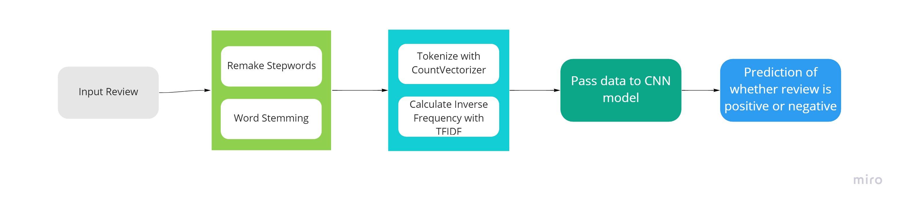
System Architecture
Data Cleaning
Feature Extraction
Approved by AICTE |Affiliated to VTU | Recognized by UGC with 2(f) & 12(B) status |Accredited by NBA and NAAC

Slide 7
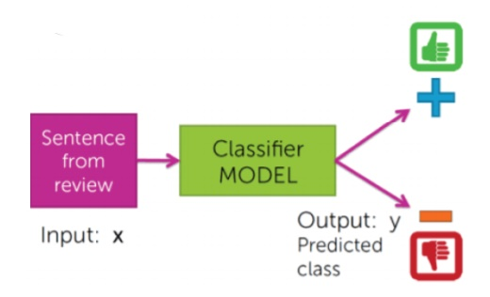
Flowchart for how the system works
Approved by AICTE |Affiliated to VTU | Recognized by UGC with 2(f) & 12(B) status |Accredited by NBA and NAAC

Slide 8
Keras
Keras is an open-source software library that provides a Python interface for artificial neural networks.
Keras contains numerous implementations of commonly used neural-network building blocks such as layers, objectives, activation functions, optimizers, and a host of tools to make working with image and text data easier to simplify the coding necessary for writing deep neural network code.
In addition tostandard neural networks, Keras has support for convolutional and recurrent neural networks.
Keras allows users to productize deep models on smartphones (iOS and Android), on the web, or on the Java Virtual Machine.
Approved by AICTE |Affiliated to VTU | Recognized by UGC with 2(f) & 12(B) status |Accredited by NBA and NAAC

Slide 9
Flask (Web framework)
Flask is a micro web framework written in Python. It is classified as a microframework because it does not require particular tools or libraries.^{[2]} It has no database abstraction layer, form validation, or any other components where pre-existing third-party libraries provide common functions. However, Flask supports extensions that can add application features as if they were implemented in Flask itself. Extensions exist for object-relational mappers, form validation, upload handling, various open authentication technologies and several common framework related tools.
Applications that use the Flask framework include Pinterest and LinkedIn.
Approved by AICTE |Affiliated to VTU | Recognized by UGC with 2(f) & 12(B) status |Accredited by NBA and NAAC

Slide 10
Scikit-learn (sklearn)
Scikit-learn (formerly scikits.learn and also known as sklearn) is a free software machine learning library for the Python programming language.
Scikit-learn is largely written in Python, and uses NumPy extensively for high-performance linear algebra and array operations. Furthermore, some core algorithms are written in Cython to improve performance.
Scikit-learn integrates well with many other Python libraries, such as Matplotlib and plotly for plotting, NumPy for array vectorization, Pandas dataframes, SciPy, and many more.
Approved by AICTE |Affiliated to VTU | Recognized by UGC with 2(f) & 12(B) status |Accredited by NBA and NAAC

Slide 11
Natural Language Processing (NLP)
Natural language processing (NLP) is a subfield of linguistics, computer science, and artificial intelligence concerned with the interactions between computers and human language, in particular how to program computers to process and analyze large amounts of natural language data.
The result is a computer capable of "understanding" the contents of documents, including the contextual nuances of the language within them. The technology can then accurately extract information and insights contained in the documents as well as categorize and organize the documents themselves.
Approved by AICTE |Affiliated to VTU | Recognized by UGC with 2(f) & 12(B) status |Accredited by NBA and NAAC

Slide 12
Implementation
Get extracted data.
Clean the data out of all special characters.
Remove stopwords
Perform stemming
Create a vocabulary using CountVectorizer.
Create inverse frequency using TFIDF.
Create a sequential CNN model using Keras.
Create necessary hidden layers with activation layer RELU.
Set the activation function of the output tensor to the SIGMOID.
Pass the data to the CNN model.
Approved by AICTE |Affiliated to VTU | Recognized by UGC with 2(f) & 12(B) status |Accredited by NBA and NAAC

Slide 13
Advantages and Disadvantages
Advantages
  Deep learning model
  It can be deployed in large scale operations.
  Bag of words model used is fine tuned.
  If you have thousands of feedback per month, it is impossible for one person to read all of these responses. By using sentiment analysis we are automating this process.
Disadvantages
  The project is not outputting into any CSV or JSON file.
  While sentiment analysis is useful, it is not a complete replacement for reading survey responses.
Approved by AICTE |Affiliated to VTU | Recognized by UGC with 2(f) & 12(B) status |Accredited by NBA and NAAC

Slide 14
Future Scope
The model can be made to work better with single line reviews.
Add multi class classification.
Increase the model accuracy.
Existing sentiment analysis models can be improved further with more semantic and commonsense knowledge.
We can add a feature where the model outputs to a CSV or JSON file.
Approved by AICTE |Affiliated to VTU | Recognized by UGC with 2(f) & 12(B) status |Accredited by NBA and NAAC

Slide 15
Conclusion
Data pre-processing is extremely necessary to get better accuracy.
Data cleaning is extremely imperative for better accuracy.
In this project, we are classifying professional reviews into positive or negative using deep learning model. This allows the model to be deployed in large scale operations.
This can be used for better feedback on movies.
Approved by AICTE |Affiliated to VTU | Recognized by UGC with 2(f) & 12(B) status |Accredited by NBA and NAAC

Slide 16
References
“The Sequential Model” https://keras.io/guides/sequential_model/
“How to Easily Deploy Machine Learning Models Using Flask” https://www.kdnuggets.com/2019/10/easily-deploy-machine-learning-models-using-flask.html
How to Encode Text Data for Machine Learning with scikit-learn https://machinelearningmastery.com/prepare-text-data-machine-learning-scikit-learn/
Approved by AICTE |Affiliated to VTU | Recognized by UGC with 2(f) & 12(B) status |Accredited by NBA and NAAC

Slide 17
Thank you
Approved by AICTE |Affiliated to VTU | Recognized by UGC with 2(f) & 12(B) status |Accredited by NBA and NAAC

